Slide 1


Elite Youth Player Development Workshop
Nyon 15-18 April 2016
THE VAMEVAL TEST AND
USE OF THE RESULTS IN FOOTBALL TRAINING
GEORGES CAZORLA
cazorlageorges@gmail.com
Research Committee FFF-DTN

Slide 2
CONTENTS
1 – Definitions
2 – How to choose a test
3 – Comparison of the main tests: VAMEVAL protocols
4 – In-depth analysis of VAMEVAL
5 – How to use VAMEVAL test results
6 – How to use maximum aerobic speed (MAS) in
training

Slide 3
SOME INITIAL DEFINITIONS
Maximal rate of oxygen consumption
% of VO2max, MAP (maximum aerobic power) or MAS which can be used for long periods
AEROBIC CAPACITY
.
.
MAX OXYGEN CONSUMPTION:
VO₂ max
(Genetic factors + training)
AEROBIC ENDURANCE:
% of VO2 max
(Training)
ECONOMY OF MOVEMENT
(Training + drills
+ specific strength exercises )
MAXIMUM AEROBIC SPEED (MAS)
MAS is the lowest speed at which VO2 max is attained. It is the result of the interaction between VO2max and economy of movement, and is an important measure for managing training intensity
Smallest amount of energy needed to move over a given distance at a given speed

Slide 4
CONTENTS
1 – Definitions
2 – How to choose a test
3 – Comparison of the main tests: VAMEVAL protocols
4 – In-depth analysis of VAMEVAL
5 – How to use VAMEVAL test results
6 – How to use maximum aerobic speed (MAS) in
training

Slide 5
Numerous tests are currently used in football to evaluate aerobic capacity.
However the majority of them have never been scientifically validated.
When a coach or physical trainer uses one of these tests, the following questions arise:
Is this test useful?
What do I want to achieve with this test?
Why use this test instead of another one?
How can I use the results I get from this test?

Slide 6
VALIDITY
proof that the test measures what it is supposed to measure
TRUSTWORTHINESS
(Reproducibility)
The same test done consecutively
with the same athletes should
produce stable results
RELEVANCE
Depending on the abilities
to be measured
FACTORS FOR CHOOSING
AND/OR DEVELOPING
A TEST
PRE-EXISTING BENCHMARKS
By sex, age and specialism
ACCESSIBILITY
Easy to carry out
using available resources
FUNCTIONALITY
A test is functional when its
results can be used to manage
exercise intensity

Slide 7
RELEVANCE
WHY TEST AND DEVELOP
AEROBIC CAPACITY IN FOOTBALL?
High aerobic capacity allows an athlete:
1- to be more active without becoming overly fatigued during a match lasting 2 × 45 minutes
2- to recover better between two or more intensive efforts
3- to increase training capacity (in both intensity and duration)

Slide 8
VALIDITY
FROM DIRECT TESTING…
TO TRAINING GROUND TESTS
ACCESSIBLE TO LARGER NUMBERS

Slide 9
RUNNING TESTS
FROM THE LAB…TO THE PITCH
MEASURING AEROBIC
RUNNING SPEED ON THE PITCH
DIRECTLY MEASURING VO2 MAX
ON THE TREADMILL

Slide 10
FUNCTIONALITY
A test is said to be functional when the result(s) can be used to guide and control coaching or training and to make modifications to training sessions

Slide 11
CONTENTS
1 – Definitions
2 – How to choose a test
3 – Comparison of the main tests: VAMEVAL protocols
4 – In-depth analysis of VAMEVAL
5 – How to use VAMEVAL test results
6 – How to use maximum aerobic speed (MAS) in
training

Slide 12
CLASSIFYING THE DIFFERENT TESTS FOR
EVALUATING AEROBIC CAPACITY:
AEROBIC ENDURANCE (AE),
MAXIMUM AEROBIC POWER (MAP)
OR MAXIMIM AEROBIC SPEED (MAS)
CONTINUOUS TESTS
PROGRESSIVE TESTS

Slide 13
TESTS
CONTINUOUS
Tests by K. COOPER (1968) : endurance?
Time limit: % MAS (endurance)
PROGRESSIVE
CONTINUOUS
Test by Léger and Boucher (1980): MAS
SPRINT RACE
Test VAM-EVAL (1993): MAS
Shuttle run test (Léger and Lambert 1982):
MAP
SHUTTLE RUNS
INTERVALS
Test by University of Bordeaux 2 (1990):
MAS + HR - Lactate
SPRINT RACE
SHUTTLE RUNS
Yoyo Test (Bangsbo 2008 ) : > MAS + RVA
30-15s Intermittent Recovery Test (Buchheit 2008) : > MAS + RVA

Slide 14
1 – CONTINUOUS TESTS
TRACK SPRINTS

Slide 15
CONTINUOUS TESTS
Test of either 1) 12 min or 2) 2400m (K. COOPER 1965)
Start
There are two variations of the Cooper test. The
aim of the 12 minute test is to run as far as possible
while in the 2400m test it is to run as fast as
possible. The result indicates the level of physical
fitness of the participant.
ADVANTAGES :
Very accessible, only an athletics track and a stopwatch (or watch) required
Benchmarks available set by sex and age (children, teenagers, adults, seniors)
DISADVANTAGES :
No warm-up: danger for at-risk individuals
Need to know how to run at a regular speed as fast as possible
Varying correlation with VO2max depending on the group
Does not give maximum aerobic speed (MAS)

Slide 16
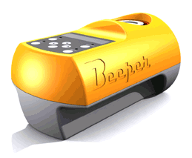
CONTINUOUS TESTS (continued)
TIME LIMIT
VO₂max
100%
50
90%
45
VO₂ (ml kg⁻¹ min⁻¹)
% of MAS
B
80%
40
A
0
50
100
150
Duration (min)
Must know MAS and how to use a beep test machine

Slide 17
ESTABLISHING A TIME LIMIT
Decide the percentage of MAS (90, 95, 100, 105 or 110 % of MAS),
regulate the beeper and measure the time set for each speed
For percentages lower than MAS monitoring HR throughout the test
and for 3 minutes afterwards can be an excellent way to establish
a physiological profile throughout the season.
>
>
>
>
>
>
>
>
>
>

Slide 18
180 -
160 -
140 -
120 -
100 -
80 -
60 -
Untrained
1
3
Overtrained
2
Trained
Heart rate (bpm)
Lactate:
1 > 3 > 2
Exercise
I I I I I I I I I I I I I
- 2 0 2 4 6 8 10
Duration (min)
Evolution of the HR curve during and after a 6 minute run maintained at 90% MAS

Slide 19
II - PROGRESSIVE TESTS
SHUTTLE RUNS
LEGER AND BOUCHER (1980)
VAMEVAL (Cazorla and Léger; 1993)

Slide 20
II - PROGRESSIVE TESTS IN A LINE
Materials needed and principles of the three following tests:
« Move to the next marker at each beep.
The interval between beeps reduces, increasing the speed as the test protocol progresses. »
- Multiple 20m or 50m sections of track
- Markers placed every 20m or 50m
- 1 CD (supplied by UEFA?) with timed beeps or a beeper

Slide 21
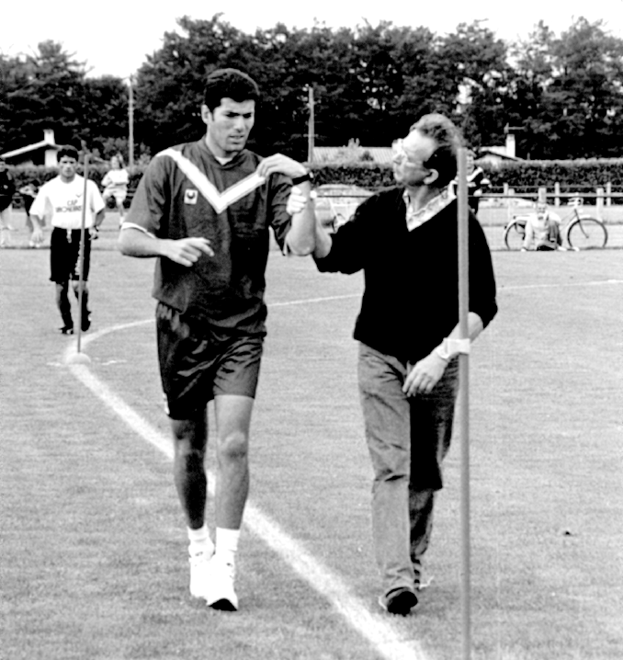
20 m
50 m
2 minute stages
Stage increase : 1km/h
1 minute stages
Stage increase : 1/2 km/h
Léger and Boucher test, 1980
VAM-EVAL Tests (Cazorla and Léger, 1993)
20 m
3 min stages, 1min rest
Speed : 8,10,12, 13, 14, 15,
16, 17, 18…km/h
University of Bordeaux 2 test,
Cazorla (1992)
With and without HR monitors

Slide 22
How to measure out a 200m track on a football pitch
^{Touchline}
^{Half-way line}
>
>
>
^{Centre circle}
>
>
^{19.10 m}
^{38.20 m}
^{19.10 m}
>
>
^{Touchline}
>
>
>
^{20 m}

Slide 23
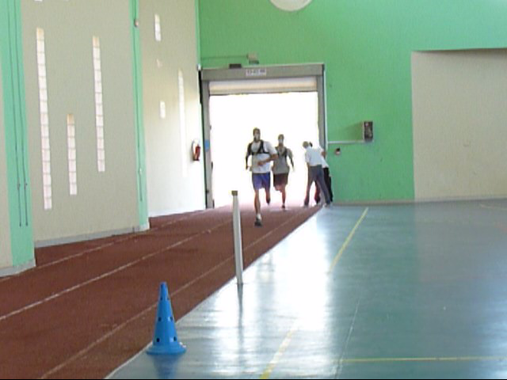
UNIVERSITY OF MONTREAL TEST
Léger L. and Boucher R. An indirect continuous running
Multistage field test: Université de Montréal
Track Test. Can J Appl Sport Sci. 5: 77-84, 1980
50 m
2 min stages
Stage increase : 1km/h
ADVANTAGES
Benchmark test/trials
Valid (Léger et Boucher 1980; Lacour et al.1991) for measuring VO2max and MAS
DISADVANTAGES
50m intervals too long to run at a regular pace
1km/hr increase per stage is too much
As a result it scores averagely for precision and accessibility

Slide 24

VAMEVAL TEST
Cazorla G. and Léger L. 1993.
20 m
ADVANTAGES
Indirect validity using the Léger and Boucher test,
Precise calculation of MAS
Possible extrapolation of VO2max
Benchmark results are available for footballers

Slide 25
II - PROGRESSIVE TESTS (continued)
2-2 CONTINUOUS SHUTTLE RUNS TEST
(Léger et al. 1981)

Slide 26
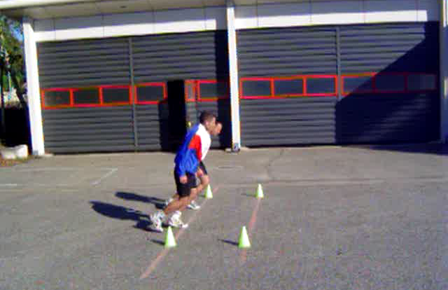
SHUTTLE-RUN TEST 20m
Léger L. and Lambert J. 1982. Eur. J. Appl. Physiol. 49
20 m
Extremely popular in France and around
the world in over 60 countries
Used in schools in France but also part of
aerboic fitness tests for firefighters,
navy and police..

Slide 27
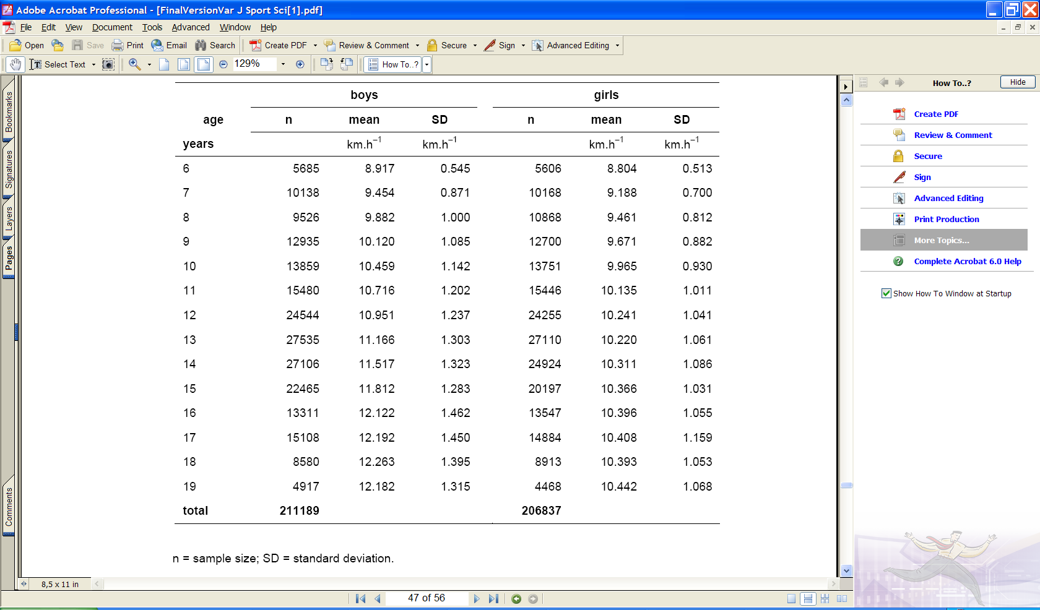
Standards calculated based on results collected from 37 countries
Olds T. Tomkinson G. Léger L. Cazorla G. 2006. Journal of Sports Sciences 24(10): 1025-1038

Slide 28
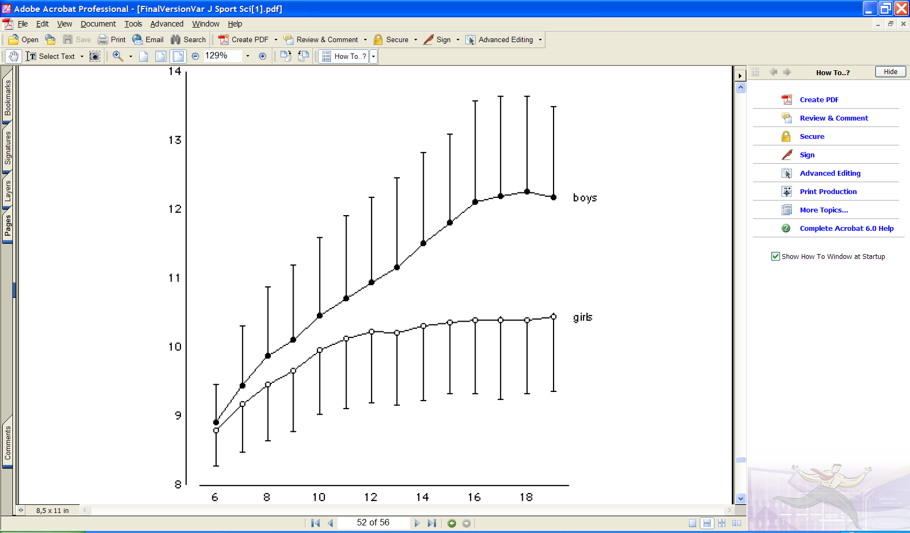
How do French adolescents rank?
•
•
•
•
•
•
•
•
•
Speed attained at the last stage (km.h⁻¹)
•
❑
❑
❑
❑
❑
❑
❑
•
❑
❑
❑
•
❑
❑
Âge
Olds T. Tomkinson G. Léger L. Cazorla G. 2006. Journal of Sports Sciences 24(10): 1025-1038

Slide 29
Based on the stage reached and the age of the participant an equation and/or a correlation table can be used to extrapolate VO₂max.
Equation : VO₂max = 31.025 + 3.238 speed (km/h) - 3.248 age (years) + 0.1536 speed (km/h) x age (years) (as per Léger et al. 1983- 84)
Table : Example of part of a correlation table
Stage | Predicted VO₂max (ml.min⁻¹.kg⁻¹) by age
(min) | 6 7 8 9 10 11 12 13 14 15 16 17 18 +
… 10 11 12 … | 65.5 64.4 63 62 60.6 59.5 58.1 56.7 55.7 54.3 53.2 51.8 50.8 67.6 66.5 65.5 64.1 63 62 60.6 59.5 58.5 57.1 56 54.6 53.6 69.7 68.6 67.6 66.5 65.5 64.4 63.4 62 60.9 59.9 58.8 57.8 56.7
But this test also depends on agility when changing direction and does not
directly give maximum aerobic speed (MAS) in a straight line.

Slide 30
Prediction of maximum aerobic speed during “normal” running based on knowledge of maximum aerobic speed during shuttle runs
_{Cazorla , Léger ,1993.}

Slide 31
II - PROGRESSIVE TEST
2-3 INTERMITTENT SPRINTS
UNIVERSITY OF BORDEAUX 2 TEST (Cazorla G., 1993)
This test should only be used if the players have heart rate monitors to measure their cardiac adaptation and if their lactate levels can be measured during the test

Slide 32
20 m
3 min intervals, 1 min rest
University of Bordeaux 2 Test, (TUB2, Cazorla, 1992)
Sports co et al version: Speed: 8,10,12, 13, 14, 15, 16, 17, 18…km/h
Long sprint version: Speed: 12, 14, 16, 17, 18, 19, 20, 21, 22, 23…km/h

Slide 33
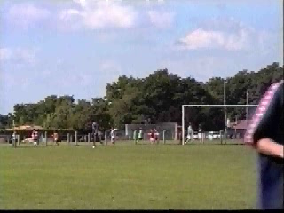
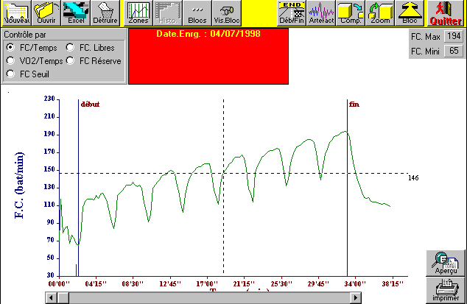
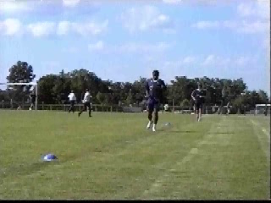
University of Bordeaux 2 test TUB2 (Cazorla G, 1992)
3 minute intervals.
- Increase the speed after each interval = 8, 10, 12, 13, 14, 15, 16, 17, 18 km/h....
- 1 minute rest between each interval (Calculations, record HR and note HR recovery rates between each interval).

Slide 34
II – PROGRESSIVE TESTS
2-4 INTERMITTENT SHUTTLE RUNS
TEST 30-15 Intermittent Fitness Test Buchheit M. 2008
Yo-Yo Intermittent Recovery Test Bansgsbo J. et al. 2008.

Slide 35
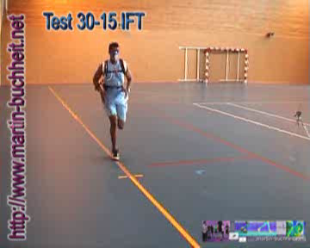
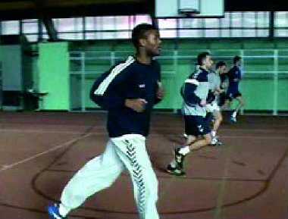

TEST 30-15
Intermittent Fitness Test
Buchheit M. Science & Sports 23: 2008
Line C
Line B
Line A
40m
Walk to return to start point
Run

Slide 36
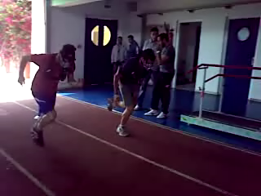
Yo-Yo Intermittent Recovery Test
Bansgsbo J., Laia M., Krustrup P. 2008. Sport Med 38(1)
20m

Slide 37
COMPARISON OF THE FIVE TESTS
n = 10 | VO2 (L.min⁻¹) | VO2 ml.min⁻¹.kg⁻¹ |  | Δ Sp. L.Bou. | HR (b.min⁻¹) | Δ Lactate (mMol/L) |  | Δ CRP (mg/L)
30-15s BUCHHEIT | 4,91 | 64,20 | 20,10* | + 3,75 | 192,7 | 10,82 * | 465% | 0,700 * | 82%
 | 0,40 | 5,59 | 1,13 |  | 10,06 | 2,21 | 95% | 0,080 | 9%
YO-YO Test | 4,90 | 63,50 | 18,31* | + 1,96 | 193 | 10,50 * | 426% | 0,686* | 82%
 | 0,44 | 4,01 | 0,77 |  | 9,64 | 2,27 | 92% | 0,130 | 15%
 |  |  | Vit km.h⁻¹
LEGER BOUCHER | 4,87 | 62,78 | 16,35 | Réf. | 192,2 | 8,13 | 347% | 0,268 | 33%
REFERENCE TEST | 0,80 | 5,12 | 1,47 |  | 8,12 | 1,92 | 82% | 0,065 | 8%
VAMEVAL | 4,84 | 62,20 | 16,65 | + 0.3 | 192,5 | 8,20 | 324% | 0,254 | 30%
 | 0,60 | 5,22 | 2,68 |  | 8,34 | 1,62 | 64% | 0,059 | 7%
SHUTTLE RUNS L. LEGER | 4,91 | 63,40 | 13,36* | - 2,99 | 193,4 | 8,14 | 332% | 0,335 | 39%
 | 0,64 | 7,62 | 1,11 |  | 10,19 | 1,32 | 54% | 0,043 | 5%

Slide 38
Max speed (40m sprint)
Speed using anerobic reserves
Speed at VO2max (MAS)
Speed in IFT or V Yo-Yo test
According to Buchheit 2010
Interval shuttle run tests at increasing speeds claim to be the most specific .
They evaluate several parameters at the same time:
MAS + anaerobic speed reserves (ASR),
+ Recovery quality between intervals,
+ Acceleration ability after a stop,
+ Agility in changing direction
Even if each one of these parameters can be of relevancein team sports, the two tests above
do not allow for any individualisation to show development of any given factor
Isn’t practising the sport under consideration the best way of establishing the specificity of a test?

Slide 39
CONCLUSION AND THOUGHTS
1- Whatever the progressive test used on the pitch, max HR and VO2max can be
reached.
2- Maximum aerobic speed (MAS) can be calculated using the three tests studied:
Léger and Boucher, VAM-EVAL and TUB2 (thesis, Josselin Laffond). These tests are
recommended for use in managing training intensity, along with knowledge
of athletes’ MAS.
3- The shuttle-run test can be used to test VO2max in children, teenagers and adults
but not MAS. This test is only recommended to estimate aerobic ability.
4- Interval shuttle run tests (Bangsbo, Buchheit) overestimate MAS because they
use anaerobic components much higher than the anaerobic speed reserves are.
Based on the fact that they are more practical (or specific), these tests are mostly
used in team sports but their functionality is questionable.

Slide 40
CONTENTS
1 – Definitions
2 – How to choose a test
3 – Comparison of the main tests: VAMEVAL protocols
4 – In-depth analysis of VAMEVAL
5 – How to use VAMEVAL test results
6 – How to use maximum aerobic speed (MAS) in
training

Slide 41
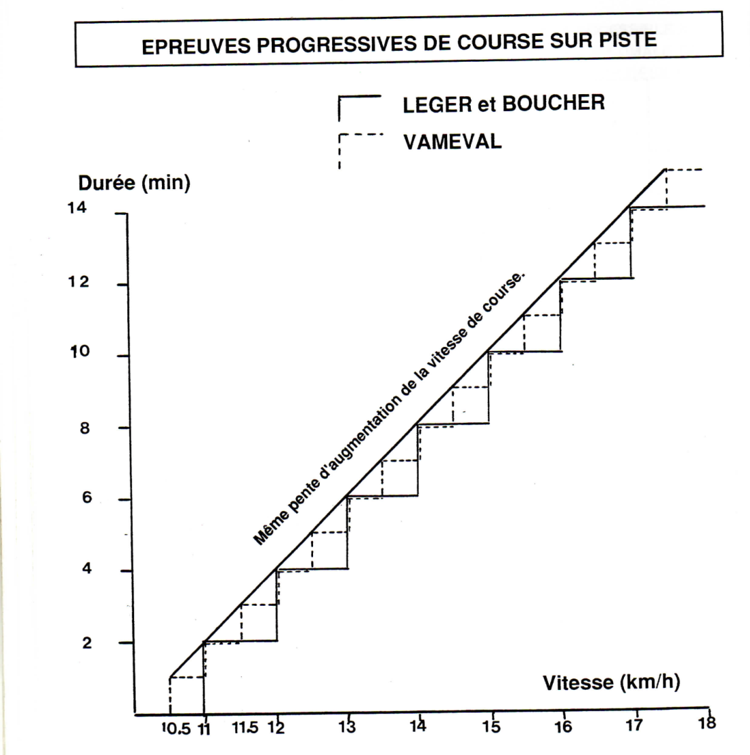
Léger L. and Boucher R. An indirect continuous running
Multistage field test : The Université de Montréal
Track Test.. Can J Appl Sport Sci. 5: 77-84, 1980
Comparison of incremental increases in the Léger-Boucher and
VAMEVAL tests. The rate of speed increase is identical in each.

Slide 42
NO SIGNIFICANT DIFFERENCE BETWEEN THE LEGER-BOUCHER AND VAMEVAL TESTS
n = 10 | VO2 (L.min⁻¹) | VO2 ml.min⁻¹.kg⁻¹ | Speed km.h⁻¹ | Δ sp. L.Bou. | HR (b.min⁻¹) | Δ Lactate (mMol/L) |  | Δ CRP (mg/L)
30-15s BUCHHEIT | 4,91 | 64,20 | 20,10* | + 3,75 | 192,7 | 10,82 * | 465% | 0,700 * | 82%
 | 0,40 | 5,59 | 1,13 |  | 10,06 | 2,21 | 95% | 0,080 | 9%
YO-YO Test | 4,90 | 63,50 | 18,31* | + 1,96 | 193 | 10,50 * | 426% | 0,686* | 82%
 | 0,44 | 4,01 | 0,77 |  | 9,64 | 2,27 | 92% | 0,130 | 15%
LEGER BOUCHER | 4,87 | 62,78 | 16,35 | Réf. | 192,2 | 8,13 | 347% | 0,268 | 33%
BENCHMARK TEST | 0,80 | 5,12 | 1,47 |  | 8,12 | 1,92 | 82% | 0,065 | 8%
VAMEVAL | 4,84 | 62,20 | 16,65 | + 0.3 | 192,5 | 8,20 | 324% | 0,254 | 30%
 | 0,60 | 5,22 | 2,68 |  | 8,34 | 1,62 | 64% | 0,059 | 7%
SHUTTLE RUNS L. LEGER | 4,91 | 63,40 | 13,36* | - 2,99 | 193,4 | 8,14 | 332% | 0,335 | 39%
 | 0,64 | 7,62 | 1,11 |  | 10,19 | 1,32 | 54% | 0,043 | 5%

Slide 43
By putting three or four players at each marker, several teams can
be tested at the same time.
>
>
>
⁰⁰⁰
⁰⁰⁰
⁰⁰⁰
⁰⁰⁰
>
>
⁰⁰⁰
>
⁰⁰⁰
>
⁰⁰⁰
>
>
>
⁰⁰⁰
⁰⁰⁰
⁰⁰⁰

Slide 44
CONTENTS
1 – Definitions
2 – How to choose a test
3 – Comparison of the main tests: VAMEVAL protocols
4 – In-depth analysis of VAMEVAL
5 – How to use VAMEVAL test results
6 – How to use maximum aerobic speed (MAS) in
training

Slide 45
HOW TO USE RESULTS OF THE VAMEVAL TEST
TO ASSESS THE PHYSIOLOGICAL
CAPACITY OF A FOOTBALLER

Slide 46
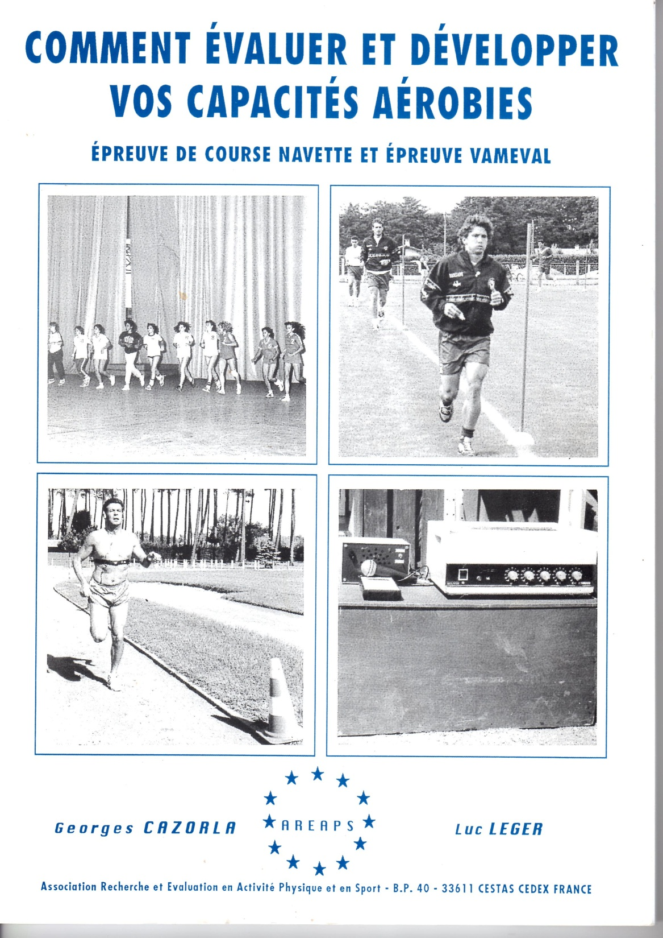
Where can you find
examples of using
MAS to manage
the intensity of
different training
sessions?
www.cress-sport.com

Slide 47
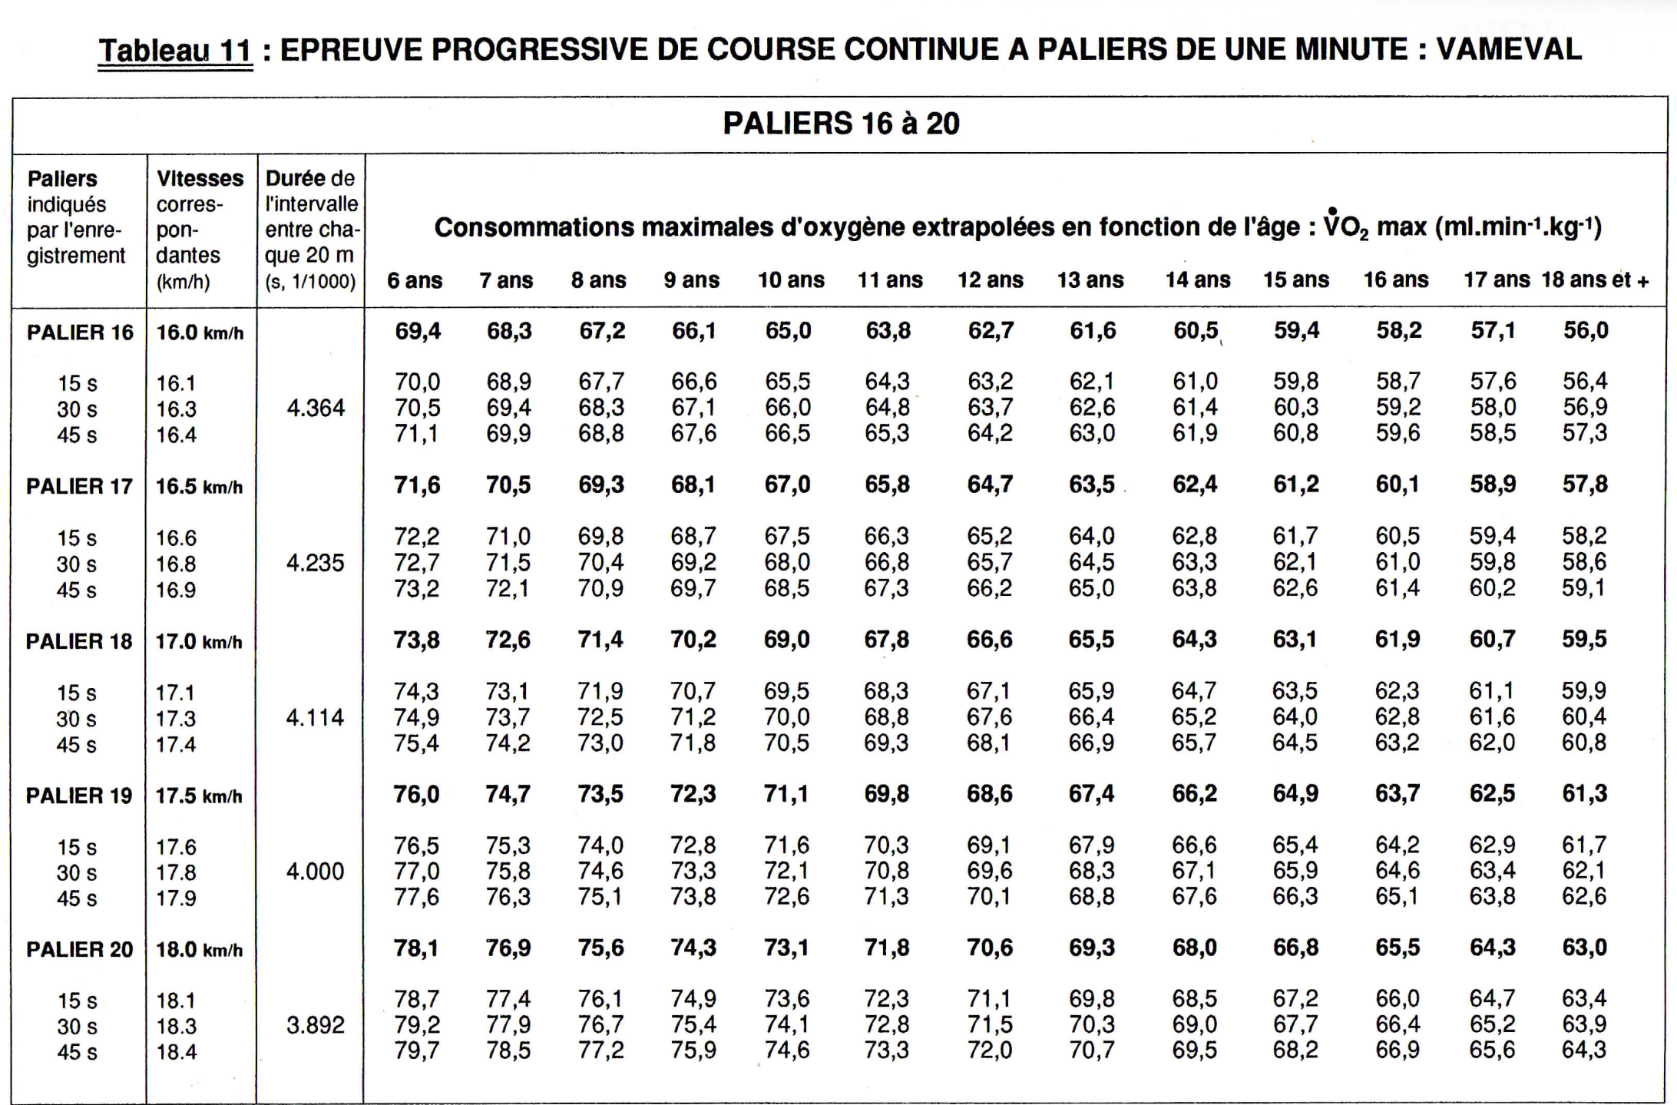

Slide 48
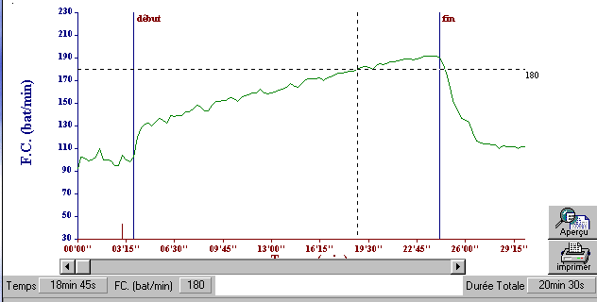
WITH A HEART RATE MONITOR...
Standard measurement of heart rate during
the VAMEVAL test (Biologiciel®)

Slide 49
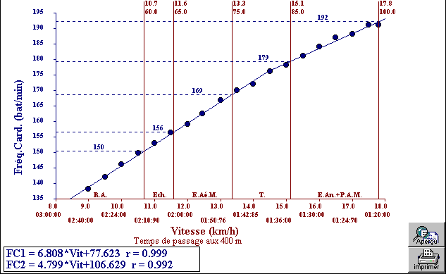
Calculating the ratio between heart rate and running speed and defining
training zones: A.R.: active recovery, WU: Warm-up, MAE: moderate aerobic endurance,
T: transition zone, AnE + MAP: anaerobic endurance + maximum aerobic power.
HR, % of MAP (or MAS), speeds and interval times over the 400m distance used here are
Automatically calculated for each zone by Biologiciel (the software used).
Equations allow HR to be extrapolated
based on run speed

Slide 50
ESTABLISHING THE LOAD
OF A MATCH OR TRAINING SESSION
ON THE BODY

Slide 51
Run speed during a match (km/h)
Standard deviation
Average
30,0
25,0
2,0
GPS +
video
4,4
2,2
20,0
1,5
1,3
Speed (km/h)
15,0
1,8
24,2
20,7
21,1
10,0
17,3
18,1
5,0
0,8
9,9
5,2
0,0
Walk
Moderate run
Fast run
Sprints from
Sprints from
Sprints after
Sprints with
moving
standing start
direction
ball
change
Run intensity during a match (% MAS)
Standard deviaton
Average
160%
15,7%
140%
22,5%
13,6%
120%
11,7%
13,4%
GPS + MAS
knowledge
100%
% MAS
80%
142,0%
60%
12,3%
120,8%
123,9%
101,9%
106,7%
40%
4,8%
58,4%
20%
30,5%
0%
Walk
Moderate run
Fast run
Sprints from
Sprints from
Sprints after
Sprints with
Cazorla et al. 2009
moving
standard start
direction
ball
change

Slide 52
ARE THERE BENCHMARKS FOR COMPARING
FOOTBALLERS WHO HAVE BEEN TESTED?

Slide 53
SCALE OF MAXIMUM AEROBIC SPEED (MAS) FOR
STRIKERS
SCALE
VAMEVAL MAS STRIKERS (km/h)
SCALE
Marks/20
13 yo
14 yo
15 yo
16 yo
17 yo
18 yo
19 yo+
Marks/20
20
17,7
19,3
18,7
18,1
18,8
19,1
19,0
20
19
17,4
18,9
18,5
17,9
18,7
18,9
18,8
19
18
17,1
18,6
18,3
17,7
18,5
18,7
18,6
18
17
16,9
18,3
18,1
17,5
18,3
18,5
18,3
17
16
16,6
17,9
17,9
17,3
18,1
18,3
18,1
16
15
16,3
17,6
17,7
17,1
18,0
18,1
17,9
15
14
16,0
17,2
17,5
16,9
17,8
17,8
17,7
14
13
15,8
16,9
17,3
16,7
17,6
17,6
17,4
13
12
15,5
16,6
17,1
16,5
17,4
17,4
17,2
12
11
15,2
16,2
16,9
16,4
17,3
17,2
17,0
11
10
14,9
15,9
16,7
16,2
17,1
17,0
16,7
10
9
14,6
15,6
16,5
16,0
16,9
16,8
16,5
9
8
14,4
15,2
16,2
15,8
16,7
16,6
16,3
8
7
14,1
14,9
16,0
15,6
16,6
16,3
16,0
7
6
13,8
14,5
15,8
15,4
16,4
16,1
15,8
6
5
13,5
14,2
15,6
15,2
16,2
15,9
15,6
5
4
13,3
13,9
15,4
15,0
16,0
15,7
15,3
4
3
13,0
13,5
15,2
14,8
15,9
15,5
15,1
3
2
12,7
13,2
15,0
14,6
15,7
15,3
14,9
2
1
12,4
12,9
14,8
14,4
15,5
15,1
14,7
1
0
12,2
12,5
14,6
14,2
15,3
14,8
14,4
0

Slide 54
SCALE OF MAXIMUM AEROBIC SPEED (MAS) FOR
MIDFIELDERS
SCALE
VAMEVAL MAS MIDFIELDERS (km/h)
SCALE
Marks/20
13 yo
14 yo
15 yo
16 yo
17 yo
18 yo
19 yo +
Marks/20
20
19,2
20,0
19,0
19,4
19,1
19,3
19,7
20
19
18,8
19,6
18,8
19,1
18,9
19,1
19,5
19
18
18,5
19,2
18,6
18,9
18,7
18,9
19,2
18
17
18,1
18,8
18,4
18,6
18,5
18,7
19,0
17
16
17,7
18,4
18,2
18,4
18,3
18,5
18,7
16
15
17,4
18,0
18,0
18,1
18,2
18,3
18,5
15
14
17,0
17,6
17,7
17,8
18,0
18,2
18,2
14
13
16,6
17,2
17,5
17,6
17,8
18,0
18,0
13
12
16,3
16,8
17,3
17,3
17,6
17,8
17,7
12
11
15,9
16,4
17,1
17,1
17,5
17,6
17,4
11
10
15,5
16,0
16,9
16,8
17,3
17,4
17,2
10
9
15,2
15,6
16,7
16,5
17,1
17,2
16,9
9
8
14,8
15,2
16,5
16,3
16,9
17,0
16,7
8
7
14,4
14,8
16,3
16,0
16,7
16,8
16,4
7
6
14,1
14,4
16,1
15,8
16,6
16,6
16,2
6
5
13,7
14,0
15,9
15,5
16,4
16,4
15,9
5
4
13,4
13,6
15,7
15,3
16,2
16,2
15,7
4
3
13,0
13,2
15,4
15,0
16,0
16,0
15,4
3
2
12,6
12,8
15,2
14,7
15,9
15,8
15,1
2
1
12,3
12,4
15,0
14,5
15,7
15,6
14,9
1
0
11,9
12,0
14,8
14,2
15,5
15,4
14,6
0

Slide 55
SCALE OF MAXIMUM AEROBIC SPEED (MAS) FOR
DEFENDERS
SCALE
VAMEVAL MAS DEFENDERS (km/h)
SCALE
Marks/20
13 yo
14 yo
15 yo
16 yo
17 yo
18 yo
19 yo +
Marks/20
20
19,1
18,2
19,0
18,5
18,6
18,8
19,1
20
19
18,7
17,9
18,7
18,3
18,4
18,6
18,9
19
18
18,4
17,6
18,4
18,0
18,3
18,5
18,7
18
17
18,1
17,4
18,1
17,8
18,1
18,3
18,5
17
16
17,8
17,1
17,8
17,6
17,9
18,1
18,3
16
15
17,4
16,8
17,5
17,4
17,8
17,9
18,1
15
14
17,1
16,6
17,2
17,2
17,6
17,7
17,9
14
13
16,8
16,3
16,9
17,0
17,4
17,5
17,7
13
12
16,4
16,1
16,6
16,7
17,3
17,4
17,5
12
11
16,1
15,8
16,3
16,5
17,1
17,2
17,3
11
10
15,8
15,5
16,0
16,3
16,9
17,0
17,0
10
9
15,4
15,3
15,7
16,1
16,8
16,8
16,8
9
8
15,1
15,0
15,3
15,9
16,6
16,6
16,6
8
7
14,8
14,7
15,0
15,7
16,4
16,5
16,4
7
6
14,4
14,5
14,7
15,4
16,3
16,3
16,2
6
5
14,1
14,2
14,4
15,2
16,1
16,1
16,0
5
4
13,8
14,0
14,1
15,0
15,9
15,9
15,8
4
3
13,4
13,7
13,8
14,8
15,8
15,7
15,6
3
2
13,1
13,4
13,5
14,6
15,6
15,5
15,4
2
1
12,8
13,2
13,2
14,4
15,4
15,4
15,2
1
0
12,4
12,9
12,9
14,1
15,3
15,2
15,0
0

Slide 56
SCALE OF MAXIMUM AEROBIC SPEED (MAS) FOR
GOALKEEPERS
SCALE
VAMEVAL MAS GOALKEEPERS (km/h)
SCALE
Marks/20
14-15 yo
16-17 yo
18 yo +
Marks/20
20
18,0
18,0
18,3
20
19
17,8
17,7
18,0
19
18
17,6
17,5
17,8
18
17
17,4
17,3
17,5
17
16
17,2
17,0
17,2
16
15
17,0
16,8
17,0
15
14
16,8
16,5
16,7
14
13
16,6
16,3
16,4
13
12
16,4
16,1
16,2
12
11
16,2
15,8
15,9
11
10
16,0
15,6
15,7
10
9
15,8
15,3
15,4
9
8
15,6
15,1
15,1
8
7
15,4
14,9
14,9
7
6
15,2
14,6
14,6
6
5
15,0
14,4
14,4
5
4
14,8
14,2
14,1
4
3
14,6
13,9
13,8
3
2
14,4
13,7
13,6
2
1
14,2
13,4
13,3
1
0
14,0
13,2
13,0
0

Slide 57
MAXIMUM AEROBIC SPEED and LEVEL OF PROFICIENCY
A minimum MAS of 17.5 km/h seems to be needed in order
to play football at a good level.
**
French team
1998 n= 23
L1 Professionals
n = 165
L2 Professionals
n = 115
U19
n = 98
** sinificatif f < 0.01

Slide 58
WHEN SHOULD THE VAMEVAL TEST BE
USED DURING THE SEASON?

Slide 59
MAS DEVELOPMENT DURING A SEASON
MAS increases during the first eight weeks of the season but not afterwards
**
NS
NS
*
*
Significant P < 0.05
P < 0.01
* *

Slide 60
CONTENTS
1 – Definitions
2 – How to choose a test
3 – Comparison of the main tests: VAMEVAL protocols
4 – In-depth analysis of VAMEVAL
5 – How to use VAMEVAL test results
6 – How to use maximum aerobic speed (MAS) in
training

Slide 61
VO₂max (ml.min⁻¹.kg⁻¹ )
= MAS (km/h) x 3.5
à ± 5% Léger and Mercier (1983)
MAS can
allow you to
1
Extrapolate
VO₂ max
2
3
Calculate
endurance
Manage the
intensity of
running sessions
Endurance = time maintaining
a % of MAS (limited period)

Slide 62
ASSESSING AEROBIC ENDURANCE IN A LIMITED TIMEFRAME
Aerobic endurance, which is the % of MAS which can be used over
a long time period, can also be assessed using the VAMEVAL test.
Start by conducting the VAMEVAL test 2) separate groups by
ability 3) programme the beeper or use the pre-programmed CD:
set MAS at a % = 90, 95, 100, 105%..., start the stopwatch…
>
>
>
>
>
>
>
>
>
>

Slide 63
Single limited-duration test
Time spent at 100% of MAS
MAS determined by Léger et Boucher’s (1980) running test
TIME SPENT AT 100% OF MAS = AEROBIC ENDURANCE
Very high | High | Average | Low | Very low
> 11 min | 7-10 min | 5- 6 min | 3-4 min | < 3 min
MAS determined by the VAMEVAL test

Slide 64
CONTENTS
1 – Definitions
2 – How to choose a test
3 – Comparison of the main tests: VAMEVAL protocols
4 – In-depth analysis of VAMEVAL
5 – How to use VAMEVAL test results
6 – How to use maximum aerobic speed (MAS) in
training

Slide 65
VO₂max (ml.min⁻¹.kg⁻¹ )
= MAS (km/h) x 3.5
à ± 5% Léger and Mercier (1983)
MAS can
allow you to
1
Extrapolate
VO₂ max
2
3
Calculate
endurance
Manage the
intensity of
running sessions
Endurance = time maintaining
a % of MAS (limited period)

Slide 66
HOW SHOULD MAS BE USED
IN TRAINING?

Slide 67
Different types of training session:
- Continuous training, submax (60–80% MAS) long duration (aerobic endurance
development: pre-season and first week back at training),
- Fartlek (Mixed development of endurance + maximum aerobic power: first 15 days of training),
- Interval training:
- Long intervals ([4 to 8 min: 1 min recovery] x 3–6 reps) submax and max (80–100 % MAS): (Mixed development of maximum aerobic power + endurance: first 3 weeks back at training),
- Short intervals ([30sec to 3 min: 3-4min recovery] x 2–4 reps) max and ABOVE max (100–130 % MAS) (Anaerobic lactic power development 30–60 s + anaerobic endurance: 2–3 min: 6 weeks after returning to training)
- Sprints ([10 sec on, 15 sec off/20 sec on, 15 sec off] x 40) : intermittent short above max (110–130 % MAS): maximum aerobic power development
- Short sprint reps: ([20m x 12–15 reps: 30sec] x 2–4 sets: 4–6 min activity): Development of sprint repetition capacity + increased aerobic-oxidative muscle power

Slide 68
Different training sessions dependant on % of MAS:
Type of training | Characteristics | Duration | % MAS | Rest period | Development
Continuous | Submax long duration, marathon type. Long Slow Distance (LSD), | > 30 min | 60–80 |  | Aerobic endurance
Mixed | Fartlek (3/4-1/4; 2/3-1/3; 1/2 –1/2) | > 20 min | 110–140 | Active 40–60 | Endurance + MAP
Interval training:
Long | Submax, max | 5–8 min x 4–6 reps | 80–100 | Rest 1–2 mins | Endurance + MAP + anaerobic lactic power development
Medium | Max and above max | 30 sec–3 min x 3–5 | 100–140 | Rest 3–4 mins | Anaerobic lactic power development + MAP
Short | Intermittent runs | 10–20 sec x 30–40 | 110 –130 | Rest 15–30 sec | MAP
Very short | Sprint reps | 20–30m x 10–15 | Max speed | Rest 30–40 sec | Speed endurance + aerobic-oxidative muscle power
Intermittent | Competition time, or by 4, 5, 6...10 | Depends on comp. | > Race speed | Active | Specific endurance

Slide 69
Physiological impact depending on % of MAS used in training.
% of MAS |  | TYPE OF EXERCISE | DESIRED OUTCOME. POINT IN SEASON
50–55 |  | 9–10 minutes continuous physical activity | Active recovery after exercise over lactate threshold
55–65 |  | 7–10 minutes continuous physical activity | Pre-training warmup. No effect on aerobic capacity development.
65–75 |  | > 15 mins continuous physical activity | Moderate endurance: beginning of pre-season.
75–85 |  | < 15 mins running or constant activity | Developing specific endurance: Pre-season and during competition season (individual sports)
85–100 |  | Long intervals: 3–5 min with 2–3 min recovery | Developing maximum aerobic power and lactate tolerance. Pre-season and during competition season (team sports)
100–130 |  | Short intervals (15s–15s) | Maximum aerobic power development. Beginning of season and competition season (team sports)
100–155 |  | Exercises over short intervals: 1–2 min with 4 min recovery | Endurance and anaerobic lactic power. Pre-competition period (for highly trained athletes)

Slide 70
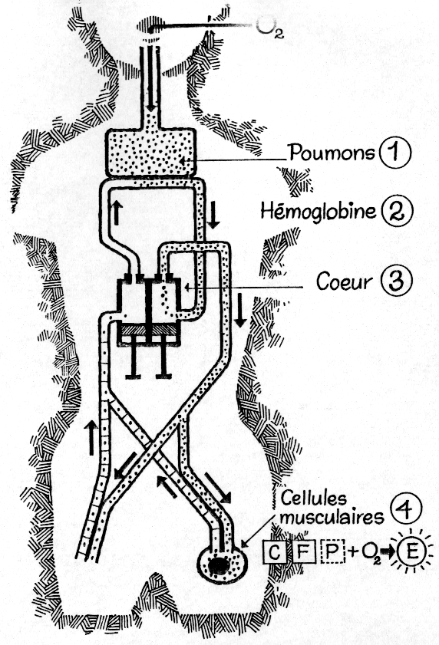
DEVELOPING AEROBIC CAPACITY DURING THE SEASON
Aerobic endurance: Off season < MAS (65–85% MAS, > 20 min)
Aerobic
endurance
MAP: fartlek: beginning of the season: (10–20s accelerations at 120–140% of MAS) × 15–20 reps > 20 min
Maximum
aerobic
power
Sprint intervals: In season [10–15s at 110–130% of MAS:
15–20 s rest ] × 30–40 reps
Sprint reps: In season
[ 3–5 s at 96–100% benchmark
speed: 30–40 s rest] × 10–15 reps
Aerobic-oxidative
muscle power

Slide 71
DEVELOPING AEROBIC CAPACITY

Slide 72
AEROBIC ENDURANCE
DURING THE OFF-SEASON, PRE-SEASON TRAINING
OR DURING WARMUPS
Examples of continuous exercises which use MAS

Slide 73
Δ
Δ
1250m
955m
Δ
Example of a runner with a modest
MAS of 16.1 km/h who wants to
develop their aerobic endurance
to 75 % of their MAS
2000m
Δ
500m
3500m
Δ
Start-finish
Δ
6800m
2800m
Δ
3000m
5390m
Δ
Δ
Δ
6000m
4000m
Δ
5000m
4450m
Δ
Δ

Slide 74
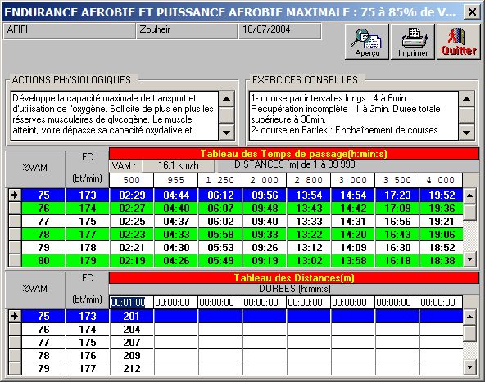

Slide 75
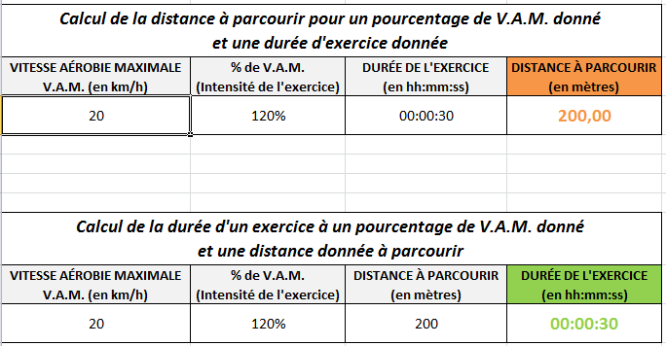

Slide 76
Δ
Δ
1,250m
955m
6 min 12
4 min 44
Δ
Example of a runner with a modest
MAS of 16.1 km/h who wants to
develop their aerobic endurance
to 75 % of their MAS
2,000m
9 min 56
Δ
500m
2 min 29
3,500m
17 min 23
Δ
Start-finish
Δ
6,800m
13 min 54
33 min 47
2,800m
Δ
26 min 46
3,000m
5,390m
Δ
14 min 54
Δ
29 min 48
Δ
6,000m
4,000m
24 min 50
19 min 52
Δ
5,000m
4,450m
Δ
Δ
22 min 06

Slide 77
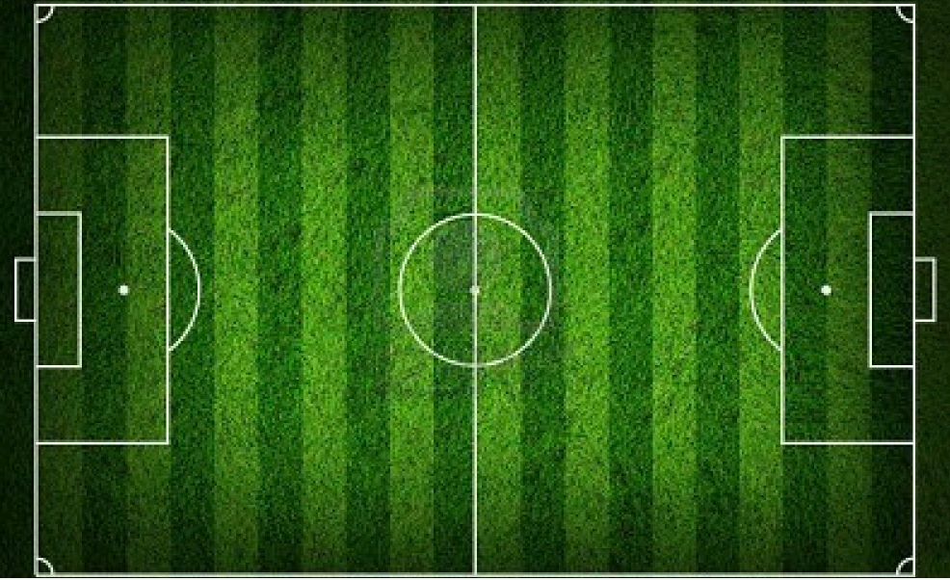
xx 16.5 km/h
Xxx
xx 17 km/h
xxx
5m
Measure the length of the track
Calculate the time for a lap or
half lap (nb software available)
5m
5m
5m
xx 17.5 km/h
xxx
Xx 18 km/h
xxx

Slide 78
MAXIMUM AEROBIC POWER
Throughout the season
Example of interval training using MAS

Slide 79
Interval training: 15sec Sprint – 15sec Recovery
With sprints of equal rest, short interval training can be 1.5–2 times as effective a mode of training as continuous exercise.
There are numerous variations thatcan be introduced… with and without a ball.
The variations of intensity, duration of exercise, duration of recovery period and total number of reps depend on the fitness
level of the players.

Slide 80
1- Don’t plan this type of training any earlier than two or three weeks back into pre-season training (in the case of three training sessions a week)
2- Start with short duration and limited above max intensity (105–110% of MAS), recovery time double the interval time and with a number of reps giving a total duration equal to or slightly more than ten minutes.
Example: [10 sec sprints at 110% of MAS: 20 sec recovery] x 25
Then progressively increase volume first of all:
Increase the number of reps from 25 to 30, 35, 35 and then 40
Increase duration of each sprint from 10 seconds to 15
Next increase intensity
- Increase MAS from 110 to 115, 120, 125 then 130%
- Decrease recovery time from 20 seconds to 15 then 10

Slide 81
Putting in place one of these training sessions with a group of players of similar ability and fitness is easy: a football pitch is the ideal size
1- Start by evaluating the MAS of your players (VAMEVAL or Léger-Boucher test)
2- Group athletes with the same MAS together (five or six athletes in each group).
3- Calculate the distance to be covered in each interval, for example over 15 sec at 110% of MAS for each group. (These calculations can be done using Excel: see example)

Slide 82
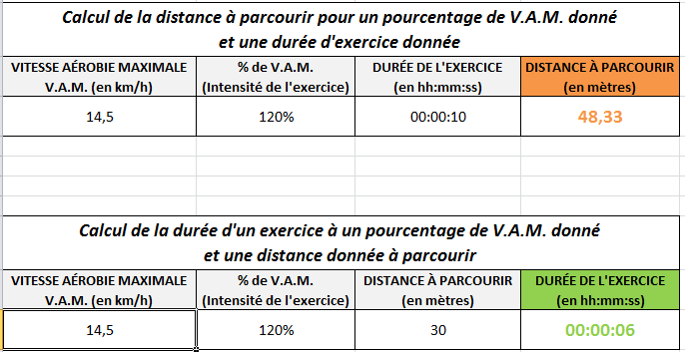

Slide 83
4- If the training session format is 15 sec sprints – 15 sec recovery, blow the whistle every fifteen seconds.
Each group must run the set distance in the 15 second period

Slide 84
Short interval training session: 15 second sprints – 15 second recovery at each end.
The footballers should be divided into groups according to their MAS. Use of a distance measurer can help mark out the length of each interval.
MAS
Groups
Distances for each group at 120% of MAS (15–15)
15 km/h
15.5 km/h
16.5 km/h
17 km/h
17.5 km/h
18km/h
18.5 km/h
19 km/h
75 m
77.5 m
82.5 m
85 m
87.5 m
90 m
92.5m
95 m

Slide 85
EXAMPLES OF INTERVAL TRAINING SESSIONS FOR DEVELOPING
- MAXIMUM AEROBIC POWER AND
- SPECIFIC ENDURANCE FOR FOOTBALL
These sessions can also be done with a ball, which increases
their intensity

Slide 86
Increase the number of reps and then increase intensity and decrease recovery time:
Example 1: [10 sec sprints at 110% of MAS: 20 sec recovery] x 25
Example 2: [10 sec sprints at 110% of MAS: 20 sec recovery] x 30 (sets of 2 x 15 or 10 +20 or 30) then 40 reps
Example 3: [15 sec sprints at 110% of MAS: 20 sec recovery] x 30
(sets of 2 x 15 or 10 +20 or 30) then 40 reps
Example 4: [15 sec sprints at 115% (then 120, 125, 130) of MAS: 20 sec recovery] x 40
Example 5: [15 sec sprints at 115% (then 120, 125) of MAS: 15 sec then 10 sec recovery] x 40

Slide 87
SOME FINAL THOUGHTS

Slide 88
ATHLETIC-TYPE PHYSICAL PREPARATION
The athlete-player. Aimed at players who can train more than three times a week (professional clubs)
The younger the footballer, the more use should be made of game-situation methods (contextualised physical preparation 4×4, 5×5, 6×6) and then integrated methods become the priority.
However the VAMEVAL or Léger-Boucher test can help to test VO2max at the beginning and throughout the season.

Slide 89
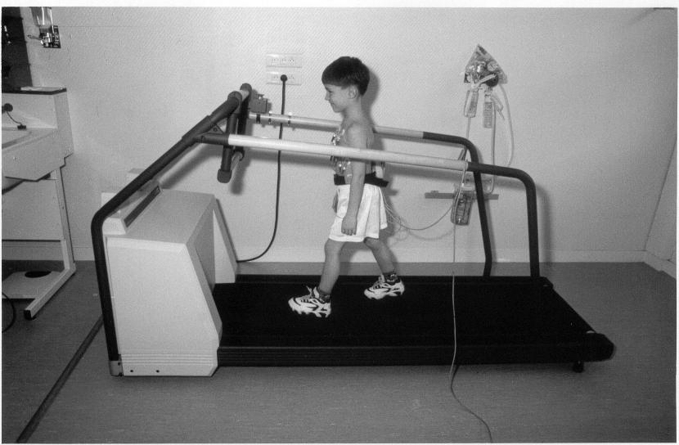
Now you know why I prefer the
VAMEVAL test!
Thank you
for your
attention!

